Slide 1



⚡
MICRO-PROJECT 13 · COURSE 25DC210
PROBABILITY & STATISTICS
SERVER RESPONSE TIME
PREDICTION
Using Regression Models — applying Probability & Statistics to model and predict uncertainty in web-service performance.
▦
1,000
⚙
4
⌇
R² = 0.9505
OBSERVATIONS
WORKLOAD PREDICTORS
VARIANCE EXPLAINED
Karunya Institute of Technology and Sciences · School of Computer Science and Technology · Division of Data Science and Cyber Security
Academic Year 2026–27 · Semester III · Batch 1 · Course Faculty: Dr. K. Rebecca Jebaseeli Edna

Slide 2


▤
AGENDA
What This Deck Covers
MICRO-PROJECT 13 · 25DC210
01
?
02
▦
03
▦
The Problem
Statistical Toolkit
Dataset & Descriptive Statistics
Response time is a random variable, not a constant.
Methods drawn from Syllabus Units IV & V of 25DC210.
1,000 time-series observations of server workload.
04
⌇
05
⌇
06
✓
Trend & Correlation
Regression & Prediction
Validation & Conclusion
How strongly each workload parameter moves with response time.
Multiple Linear Regression, coefficients and error metrics.
Student's t-test, Course Outcome mapping and takeaways.

Slide 3
?
PROBLEM & RATIONALE
Response Time Is Not a Constant —
It Is a Random Variable
Modern web services operate under continuous uncertainty. The response time a client experiences fluctuates heavily with workload and server conditions: request rate, CPU utilisation, memory pressure and network activity.
The statistical pipeline (Section 1.0 of the project)
01
Uncertainty
↓
“
PROBLEM STATEMENT
How can statistical regression models capture the uncertainty in server response time, predict it from measurable workload parameters, and provide statistical evidence that the model is reliable?
02
Statistical Modelling
↓
03
Correlation
↓
56.7 → 619.2 ms
RESPONSE TIME RANGE
04
Regression
across 1,000 observations — an ~11× range
↓
05
Prediction
↓
06
Validation
FOCUS: statistical reasoning, not black-box AI

Slide 4
⚑
SECTION 3.0 · REPORT
Aim & Objectives
1 AIM · 6 OBJECTIVES
⚑
AIM
Develop and statistically validate a regression-based model that predicts server response time from relevant workload and system-performance parameters.
▦
01
▦
02
▦
03
Collect repeated observations of workload and measured response time
Prepare and organise data for statistical analysis
Compute descriptive statistics — central tendency and variation
⌇
04
▦
05
✓
06
Examine trends and measure correlation with workload variables
Fit the regression model and predict unseen test observations
Evaluate with MAE, MSE, RMSE, R² and validate with hypothesis tests
✦
SCOPE — statistical modelling of server response time; software supports the pipeline, but the academic focus stays on statistical reasoning and validation.

Slide 5
✦
SYLLABUS UNITS IV & V
The Statistical Toolkit
5 METHOD FAMILIES
▦
01
▦
02
▦
03
▦
04
▤
05
Descriptive Statistics
Correlation
Regression
Prediction Error
Validation
Mean, median, min, max, standard deviation — establish central value & variability.
Pearson correlation; rank correlation when a rank-based view fits better.
Y = β₀ + β₁X + ε
MAE, MSE, RMSE quantify misses; R² gives variance explained.
Confidence intervals, Student's t-test, F-test, Chi-square — applied only where assumptions hold.
Multiple regression when several predictors are justified.
Data summary
Unit IV
Core model
Accuracy
Unit V
!
INSIGHT — Prediction alone proves nothing — reliability must be demonstrated statistically.

Slide 6

SYSTEM PIPELINE
From Raw Observations to Validated Insight
Ten stages — raw telemetry in, statistically validated predictions out. The analytical core (07–10) is highlighted.
01
02
03
04
05
→
→
Dataset: workload + response
→
→
Server / Web Service
Performance Observations
Data Preparation
Descriptive Stats + Trend
↓
06
07
08
09
10
→
→
→
Actual vs Predicted + Error Analysis
→
Correlation Analysis
Regression Model
Train (800) / Test (200) split
Validation & Interpretation
✦
1,000 observations
✦
80% train · 20% test
▣
4 explanatory variables

Slide 7

THE DATA
1,000 Time-Series Observations of Server Behaviour
A simulated but statistically-structured dataset: workload variables drive response time with realistic noise (seed = 42 for reproducibility), plus a slight upward trend engineered over time.
⇅
PREDICTOR
▦
PREDICTOR
▦
PREDICTOR
✦
PREDICTOR
◔
TARGET
Request Rate
CPU Usage %
Memory Usage %
Network Load
Response Time
MEAN
50 → 997
1.0 → 99.5
41.0 ± 12.8
1.0 → 51.8
56.7 → 619.2
req/s
%
%
MB/s
ms
✦
RELATIONSHIP ENGINEERED
↗
TREND COMPONENT
response ≈ 50 + 2.5·CPU + 1.5·Mem + 3.0·Net + noise — the model must recover this from data alone
+0.05 ms per time step exercises Unit IV time-series analysis

Slide 8
DESCRIPTIVE STATISTICS · UNIT IV
Response Time: Centre, Spread and Range
MEAN
STD DEV
RANGE
320.41
118.97
56.72 – 619.18
ms
ms
ms
Variable | Mean | Std Dev | Min | Max
Request Rate (req/s) | 526.77 | 276.53 | 50 | 997
CPU Usage (%) | 42.10 | 23.69 | 1.00 | 99.53
Memory Usage (%) | 41.03 | 12.84 | ≈ 9.9 | ≈ 76.9
Network Load (MB/s) | 26.32 | 13.94 | 1.02 | 51.83
⌇
COEFFICIENT OF VARIATION
≈ 37%
Response time is highly dispersed relative to its mean. This is exactly the uncertainty the regression model must explain.

Slide 9
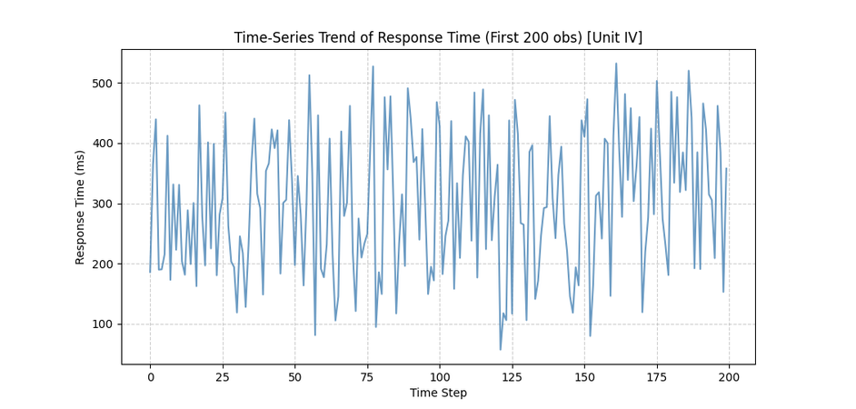
TREND · TIME-SERIES COMPONENT
A Slow Upward Drift Hides in the Noise
↗
A secular trend of about +0.05 ms per observation was engineered into the series — classic Unit IV trend component
✦
Correlation of Time_Step with response time = 0.1249 — weak, but positive and detectable
⌇
Detrending matters: ignoring drift would bias the regression residuals
Time-series trend of response time — first 200 observations (generated by server_prediction.py)
TOOL: time-series decomposition · moving averages (syllabus)

Slide 10
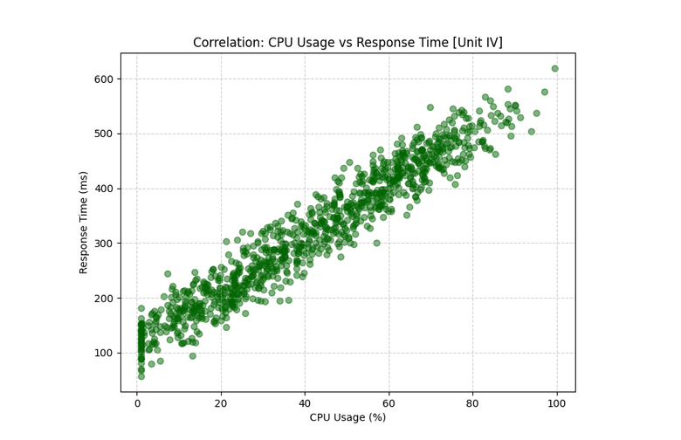
CORRELATION · PEARSON R
Every Workload Parameter Moves With Response Time
CPU Usage
0.9637
Request Rate
0.9423
Network Load
0.9388
Memory Usage
0.9099
Time Step
0.1249
Pearson r with Response_Time_ms, n = 1,000
CPU usage vs response time — near-linear cloud (r = 0.9637)
◆
All four workload predictors are strongly positively correlated — good predictive signal, but collinearity to keep in mind when reading coefficients.

Slide 11


✦
MODEL · CO4 STATISTICAL JUSTIFICATION
Multiple Linear Regression — The Fitted Equation
FITTED MODEL
Y = response time · X = workload parameters
Response_Time
=
73.53
+
0.052
·
RequestRate
+
2.416
·
CPU
+
1.447
·
Memory
+
2.220
·
Network
β₀ = 73.53 (intercept) · β₁ = 0.052 · β₂ = 2.416 · β₃ = 1.447 · β₄ = 2.220
▦
STRONGEST LEVER
✦
▦
⇅
+2.416 ms
+2.220 ms
+1.447 ms
+0.052 ms
per +1% CPU
per +1 MB/s network
per +1% memory
per +1 req/s
TERM β₂
TERM β₄
TERM β₃
TERM β₁
Fitted by ordinary least squares on 800 training observations; coefficients recover the engineered generative weights 2.5 / 1.5 / 3.0 closely — the statistics found the true signal.
CO4 — relationship justified by correlation AND regression coefficients
◆

Slide 12
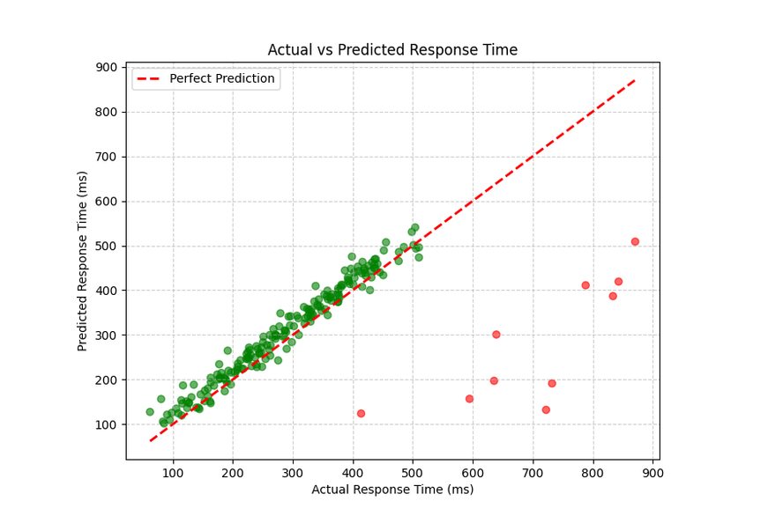

✦
PREDICTION & ERROR EVALUATION · UNIT IV
95% of Response-Time Variance Explained
MAE
20.21 ms
average absolute miss per test observation
RMSE
penalises large errors; close to MAE → errors evenly spread, few wild misses
25.26 ms
R²
0.9505
variance explained by the model
⚗
200 unseen test observations · 80/20 split
Predicted vs actual response time — points hug the ideal y = x line
◆
RMSE only ~25% above MAE and R² near 0.95 — an honest, well-behaved linear fit for a noisy system.

Slide 13
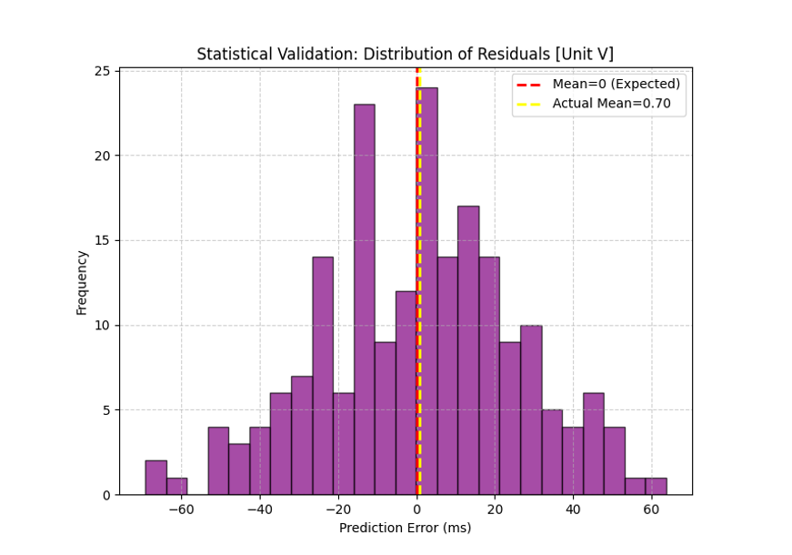
▤
HYPOTHESIS TESTING · UNIT V
Is the Model Unbiased? Let the Data Decide
H₀
mean prediction error = 0
H₁
mean error ≠ 0
⚗
One-sample Student's t-test on the 200 test residuals, α = 0.05
T-STATISTIC
P-VALUE
0.3931
0.6947
✓
p = 0.6947 > 0.05 → FAIL TO REJECT H₀ — errors are statistically centered on zero: the model is UNBIASED
A near-zero t with high p means observed misses look exactly like random noise.
Residual distribution — roughly normal, centered near 0 (red dashed line)
CO5 — validation via RMSE, R² AND hypothesis testing

Slide 14
✓
CONCLUSION · CO2–CO5
Statistics Turned Uncertainty Into a Validated Model
WHAT WE SHOWED
✓
All four workload parameters correlate strongly with response time (r = 0.91 – 0.96)
CO2
✦
CO3
⌇
Modelled uncertainty & variation in response time using workload distributions
Predicted performance under varying, uncertain workload via regression
02
03
✓
The fitted regression explains 95.05% of response-time variance (R² = 0.9505)
✓
Errors average just 20.21 ms (MAE) with no systematic bias (t-test p = 0.6947)
CO4
✦
CO5
✓
Justified the relationship with correlation + regression coefficients
Validated with RMSE, R² and Student's t-test on residuals
✓
Regression describes association, not causation — model valid within observed workload range
04
05
▦
APPLICATIONS
performance monitoring · capacity planning
➤
FUTURE WORK
larger datasets, alternative models, live monitoring dashboard

Slide 15


♛
THANK YOU
Questions & Discussion — happy to walk through the data, the model or the validation.
R²
MAE
RMSE
P
0.9505
20.21 ms
25.26 ms
0.6947 · unbiased
Micro-Project 13 · Probability & Statistics for Data Science and Cyber Security Engineers (25DC210) · Karunya Institute of Technology and Sciences · Batch 1 · Faculty: Dr. K. Rebecca Jebaseeli Edna

